Slide 1
Chapter 23 Political Paralysis in the Gilded Age, 1869-1896

Slide 2
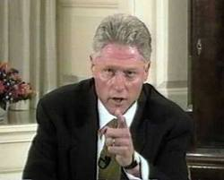
Ch. 22 Review – Johnson’s Impeached
1st President to be impeached
Only one other one has been impeached. Who? Why?
Tenure of Office Act
Passed by Congress requiring Senate to approve removal of cabinet member
Congress knew Johnson would violate law, when he did House impeached him
By margin of 1 vote, Johnson is not removed

Slide 3
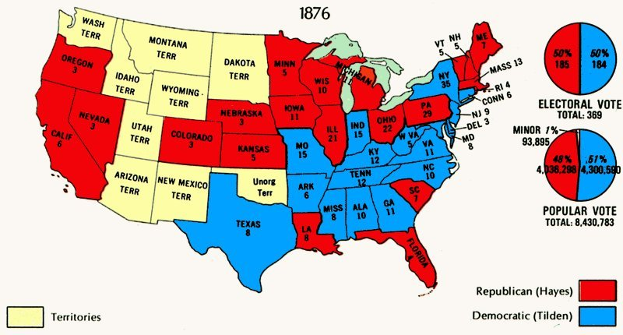
End of Reconstruction….
Compromise of 1877 ends Reconstruction…..
Chapter 23, WICKED Important

Slide 4
Chapter 23 Political Paralysis in the Gilded Age, 1869-1896

Slide 5
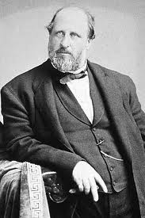
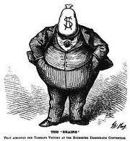
President Grant’s Administration
“Bloody Shirt”
Using Civil War memories to receive votes
Administration Scandals:
Credit Mobilier:
Railroad insiders hired themselves at inflated prices
VP of US accepted payments
Whiskey Ring:
Stole excise-tax revenues from Treasury department
Grant’s private secretary was involved
Boss Tweed:
Tammany Hall, stole over $200 million
Thomas Nast helped contribute to his capture in Spain

Slide 6
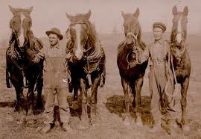

Panic of 1873
Causes:
Overproduction of RR’s, mines, factories, etc.
Bankers made too many risky loans
Effects:
Debate over hard currency vs. greenbacks
Debtors wanted greenbacks. Why?
Paper $, inflation decreased value
Lenders wanted hard currency. Why?
Hard $, not affected by inflation, increased value
VS

Slide 7
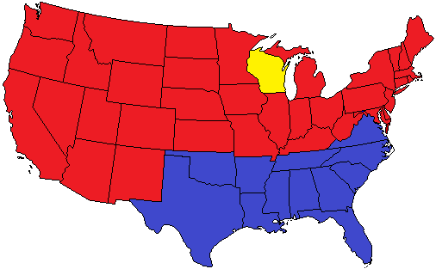
Key Terms to Know
Democrats:
“Solid South”: Democratic base in much of the South
Republicans:
Grand Army of Republic (GAR): Several 100,000 Union veterans that tended to vote Republican
Stalwarts: Led by Roscoe Conkling, believed in patronage
Half-Breeds: Led by James G. Blaine, wanted civil service reform

Slide 8
Compromise of 1877 & Civil Rights
Settled the dispute in the election of 1876 (Hayes – Republican, Tilden – Democrat)
Hayes (R) is elected
Democrats are promised:
Reconstruction ends – Military is withdrawn
Patronage, RR construction through Texas
Civil Rights Act of 1875:
Guaranteed EQUAL accommodations in public places and prohibited racial discrimination in jury selection
Civil Rights Cases (1883)
Supreme Court stated 14th amendment only prohibited government violations of civil rights, not denial by individuals
Sets up stage for Jim Crow Laws – legal segregation

Slide 9
Railroads and Immigration
1880: 9% of CA population were Asian immigrants
Asians tended to build RR and dig for gold
Leads to discrimination and resentment towards immigrants
Nativism
Chinese Exclusion Act: Limits Chinese immigration until 1943
US vs. Wong Kim Ark:
Guarantees citizenship to ALL people born in US

Slide 10
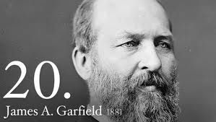
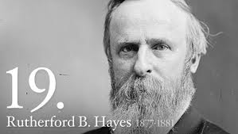
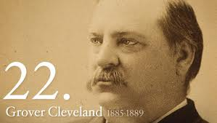
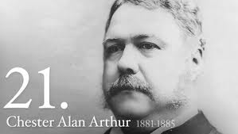
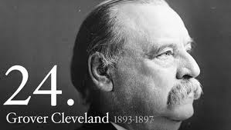
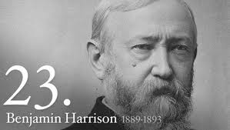
The Era of Forgotten Presidents (1877 – 1896)
Rutherford B. Hayes:
Compromise of 1877, 1st president to send troops to break up RR strike
James A. Garfield:
Died 6 months into office – Destiny of a Republic
In favor of civil service reform
Chester A. Arthur:
VP to Garfield, was a stalwart
***Pendleton Act of 1883 – Instituted Civil Service Reform***
Grover Cleveland:
Laissez-faire advocate
Benjamin Harrison:
Won electoral vote against Cleveland, lost popular vote
Grover Cleveland:
Still a laissez-faire advocate

Slide 11
Tariffs
1881: Treasury had annual surplus of $145 million
Most of government revenue came from tariffs
Cleveland wanted lower tariffs – he was a Democrat
***McKinley Tariff Act of 1890***
Highest peacetime rate ever (48.4%)
Hated by farmers, loved by North
Remember…. Republicans want to Raise tariffs

Slide 12
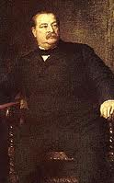
That’s it!
Tune into apushreview.com
Help spread the word!
Questions? Comments? Ideas for videos?
Email or leave in comments
Thanks for taking notes………

